Slide 1




Dr. A.P.J. Abdul Kalam Technical University, Lucknow
Centre for Advanced Studies, AKTU Campus Lucknow
Detecting Jamming Attacks in Wireless Sensor Networks Using Machine Learning
Presented By
Vivek Verma
Enrollment No. 1643110555
M.Tech Computer Science Engineering
Centre for Advanced Studies, AKTU, Lucknow

Slide 2
OUTLINE
Introduction
Related Works
Proposed Methodology
Experiments and Results
Limitation
Conclusion
Future Scope
References

Slide 3
INTRODUCTION
Wireless networks make use of shared transmission medium; therefore, they are open to several malicious attacks.
A jammer intercepts a transmission, injects spurious packets, and blocks or jams the legitimate transmissions.
Jammers, which generate high frequency noise, can significantly degrade network performance by interfering with the band width used by sending and receiving nodes.
Hence there is a need for effective detection and mitigation techniques against jamming attacks.

Slide 4
OBJECTIVES
Choose a comprehensive dataset for jamming detection.
Design and implement machine learning models for jamming detection.
Develop an accurate detection system.
Evaluate and compare the performance of different ML models on different datasets

Slide 5
RELATED WORK
Paper Title and Year | Author Name | Technology Used | Dataset | Accuracy | Advantage | Disadvantage
[1] A genetic-based extreme gradient boosting model for detecting intrusions in wireless sensor networks, 2019 | Alqahtani, M., Gumaei, A., Mathkour, H., & Maher Ben Ismail | GXGBoost | WSN-DS dataset | 99.9% for normal traffic | Proposed model outperforms the state-of-the-art models classifiers with high detection rates. | Requires high memory due to tree based structure.
[2] A Statistical Approach to Detect Jamming Attacks in Wireless Sensor Networks, 2018 | Opeyemi Osanaiye, Attahiru S. Alfa, Gerhard P. Hancke | Statistical Process Control, Exponentially Weighted Moving Average (EWMA) | Trace-driven simulation data from wireless sensor networks | 95% | Minimal computational overhead | Limited to DoS jamming attacks; may not detect other types of attacks.

Slide 6
RELATED WORK
Paper Title and Year | Author Name | Technology Used | Dataset | Accuracy | Advantage | Disadvantage
[3] An Online Ensemble Learning Model for Detecting Attacks in Wireless Sensor Networks, 2022 | Hiba Tabbaa, Samir Ifzarne, Imad Hafidi | Ensemble Learning (Homogeneous: Hoeffding Adaptive Tree; Heterogeneous: Adaptive Random Forest combined with Hoeffding Adaptive Tree) | Specialized Wireless Sensor Network Detection System (WSN-DS) dataset | Heterogeneous Ensemble : 96.84%. Homogeneous Ensemble : 97.2% | High detection accuracy. Low computational overhead suitable for resource-constrained WSNs | Limited to specific attack types (Blackhole, Grayhole, Flooding, Scheduling). May not generalize well to other types of attacks
[4] Bayesian Inference-Assisted Machine Learning for Near Real-Time Jamming Detection and Classification in 5G New Radio (NR), 2023 | Shashank Jere, Ying Wang, Ishan Aryendu, Shehadi Dayekh, Lingjia Liu | Bayesian Inference, Echo State Networks (ESN), Reservoir Computing | Cross-layer Key Performance Indicator (KPI) data collected on a Non-Standalone (NSA) 5G NR testbed | Instantaneous models: 95.4% Sequential models (including ESN): 98.8 | High detection accuracy. 180 ms instantaneous detection time. Continuous tracking of dynamic jamming conditions due to User Equipment (UE) mobility | Limited to specific jamming scenarios tested in the study

Slide 7
RELATED WORK
Paper Title and Year | Author Name | Technology Used | Dataset | Accuracy | Advantage | Disadvantage
[5] Machine learning-based jamming attack classification and effective defence technique, 2023 | Sun-Jin Lee, Yu-Rim Lee, So-Eun Jeon, Il-Gu Lee | Random Forest, BSS Coloring, Battery Draining Defense | WSN-DS | 98.16% | JCED improves network performance with 24.9% higher throughput and 23.4% lower energy consumption compared to countermeasure detection and consistency algorithm (CDCA). | Simulation-only validation; untested in real-world deployments
[6] Multi-stage Jamming Attacks Detection using Deep Learning Combined with Kernelized Support Vector Machine in 5G Cloud Radio Access Networks, 2020 | Marouane Hachimi, Georges Kaddoum, Ghyslain Gagnon, Poulmanogo Illy | MLP + KSVM | WSN-DS | 94.51% | High detection accuracy: The multi-stage ML-IDS (MLP + KSVM) achieves 94.51% accuracy with a reduced false negative rate (7.84%). | Relies on one dataset; does not include intelligent/advanced jamming attacks

Slide 8
RELATED WORK
Paper Title and Year | Author Name | Technology Used | Dataset | Accuracy | Advantage | Disadvantage
[7] Deep Learning Models for Cyber Security in IoT Networks, 2019 | Monika Roopak, Gui Yun Tian, Jonathon Chambers | MLP, CNN, LSTM, CNN+LSTM (Deep Learning Models) | CICIDS2017 | 97.16% (CNN+LSTM) | The proposed hybrid CNN+LSTM deep learning model achieves high accuracy (97.16%) for DDoS attack detection, outperforming traditional machine learning methods like SVM and Random Forest. | The approach requires longer training times and high computational resources, which can be a limitation for real-time IoT environments.
[8] Toward a Lightweight Intrusion Detection System for the IoT, 2019 | S.U. Jan, S. Ahmed, V. Shakhov, I. Koo | SVM-based IDS using packet arrival rate | Beget (generated), CICIDS2017 (subset) | 98.35% | Outperforms conventional IDS approaches like GA-SVM, A-IDS, and WFS-IDS in both detection speed and efficiency. | Relies on simulated datasets (Beget), reducing its direct applicability to real-world IoT traffic without further validation.

Slide 9
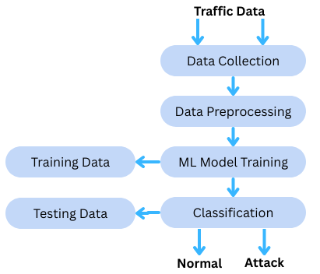
PROPOSED METHODOLOGY
System Architecture of proposed methodology

Slide 10
PROPOSED METHODOLOGY
DATASET SELECTION:
1. KDD Cup 1999 (Kaggle):
Original dataset for network intrusion detection
Contains ~4.9 million records (train+test)
41 features + 1 label (normal or attack)
Attack types: DoS, Probe, U2R, R2L
Known for data redundancy and imbalance

Slide 11
PROPOSED METHODOLOGY
DATASET SELECTION:
2. NSL-KDD:
Improved version of KDD'99
Removed redundant and duplicate records
More balanced and realistic evaluation
Easier to benchmark ML models
Divided into KDDTrain+, KDDTest+

Slide 12
PROPOSED METHODOLOGY
DATASET SELECTION:
3. CICIDS 2017:
Developed by the Canadian Institute for Cybersecurity
Represents up-to-date attack scenarios and normal traffic
Includes attacks: DDoS, Brute Force, Web, Botnet, etc.
Realistic traffic with labeled flows
Contains over 80 extracted features

Slide 13
PROPOSED METHODOLOGY
Data Preprocessing:
1. Dataset Splitting
Separated data into:
Features (X) – all input attributes
Target (y) – the output class label
Target variable excluded from feature matrix

Slide 14
PROPOSED METHODOLOGY
Data Preprocessing:
2. Handling Categorical Data
Identified categorical columns
Applied Label Encoding to:
Convert text categories to numerical values
Encode target variable for classification tasks

Slide 15
PROPOSED METHODOLOGY
Data Preprocessing:
3. Feature Standardization
Used StandardScaler to:
Transform features to have zero mean and unit variance
Normalize feature scales
Model Selection:
1. Model Chosen
LightGBM (Light Gradient Boosting Machine)
CatBoost (Categorical Boosting)

Slide 16
PROPOSED METHODOLOGY
Model Selection:
2. LightGBM
Uses leaf-wise tree growth algorithm
Highly efficient, scalable, and accurate
Best suited for structured data with complex feature interactions
Support tasks like:
Classification
Regression

Slide 17
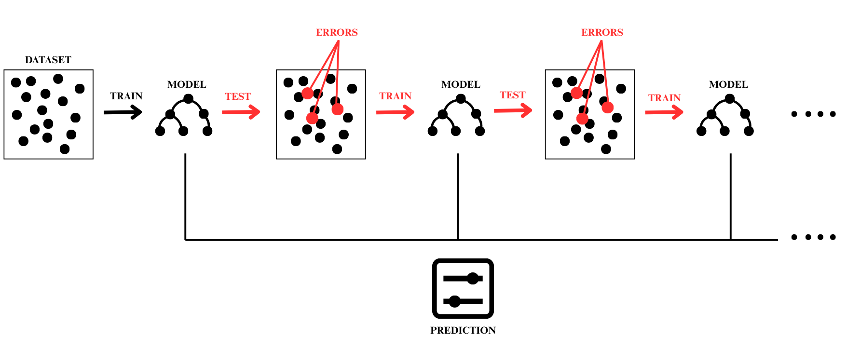
PROPOSED METHODOLOGY
Architecture Diagram of LightGBM

Slide 18
PROPOSED METHODOLOGY
Model Selection:
3. CatBoost
Designed to natively handle categorical features
Ideal for datasets with both numerical and categorical data
Robust and less prone to overfitting with default parameters
No need for extensive preprocessing of categorical variables

Slide 19
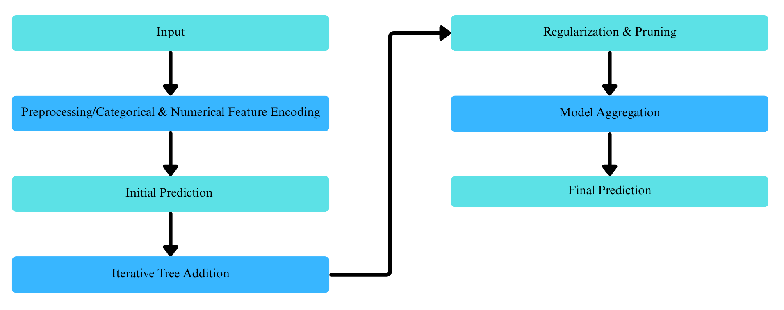
PROPOSED METHODOLOGY
Architecture Diagram of CatBoost

Slide 20
EXPERIMENTS AND RESULTS
Sr. No. | Test, Validation, Test Ratio | Model | Precision (%) | Recall (%) | F1 Score (%) | Accuracy (%)
1 | 60:20:20 | LightGBM | 99.72 | 99.32 | 99.52 | 99.32
2 | 70:15:15 |  | 99.69 | 99.48 | 99.58 | 99.48
3 | 60:10:30 |  | 99.77 | 99.08 | 99.42 | 99.08
4 | 70:10:20 |  | 99.82 | 99.62 | 99.71 | 99.62
Average |  |  | 99.75 | 99.37 | 99.55 | 99.37
Multi-Class Classification-KDD Cup 1999 Dataset

Slide 21
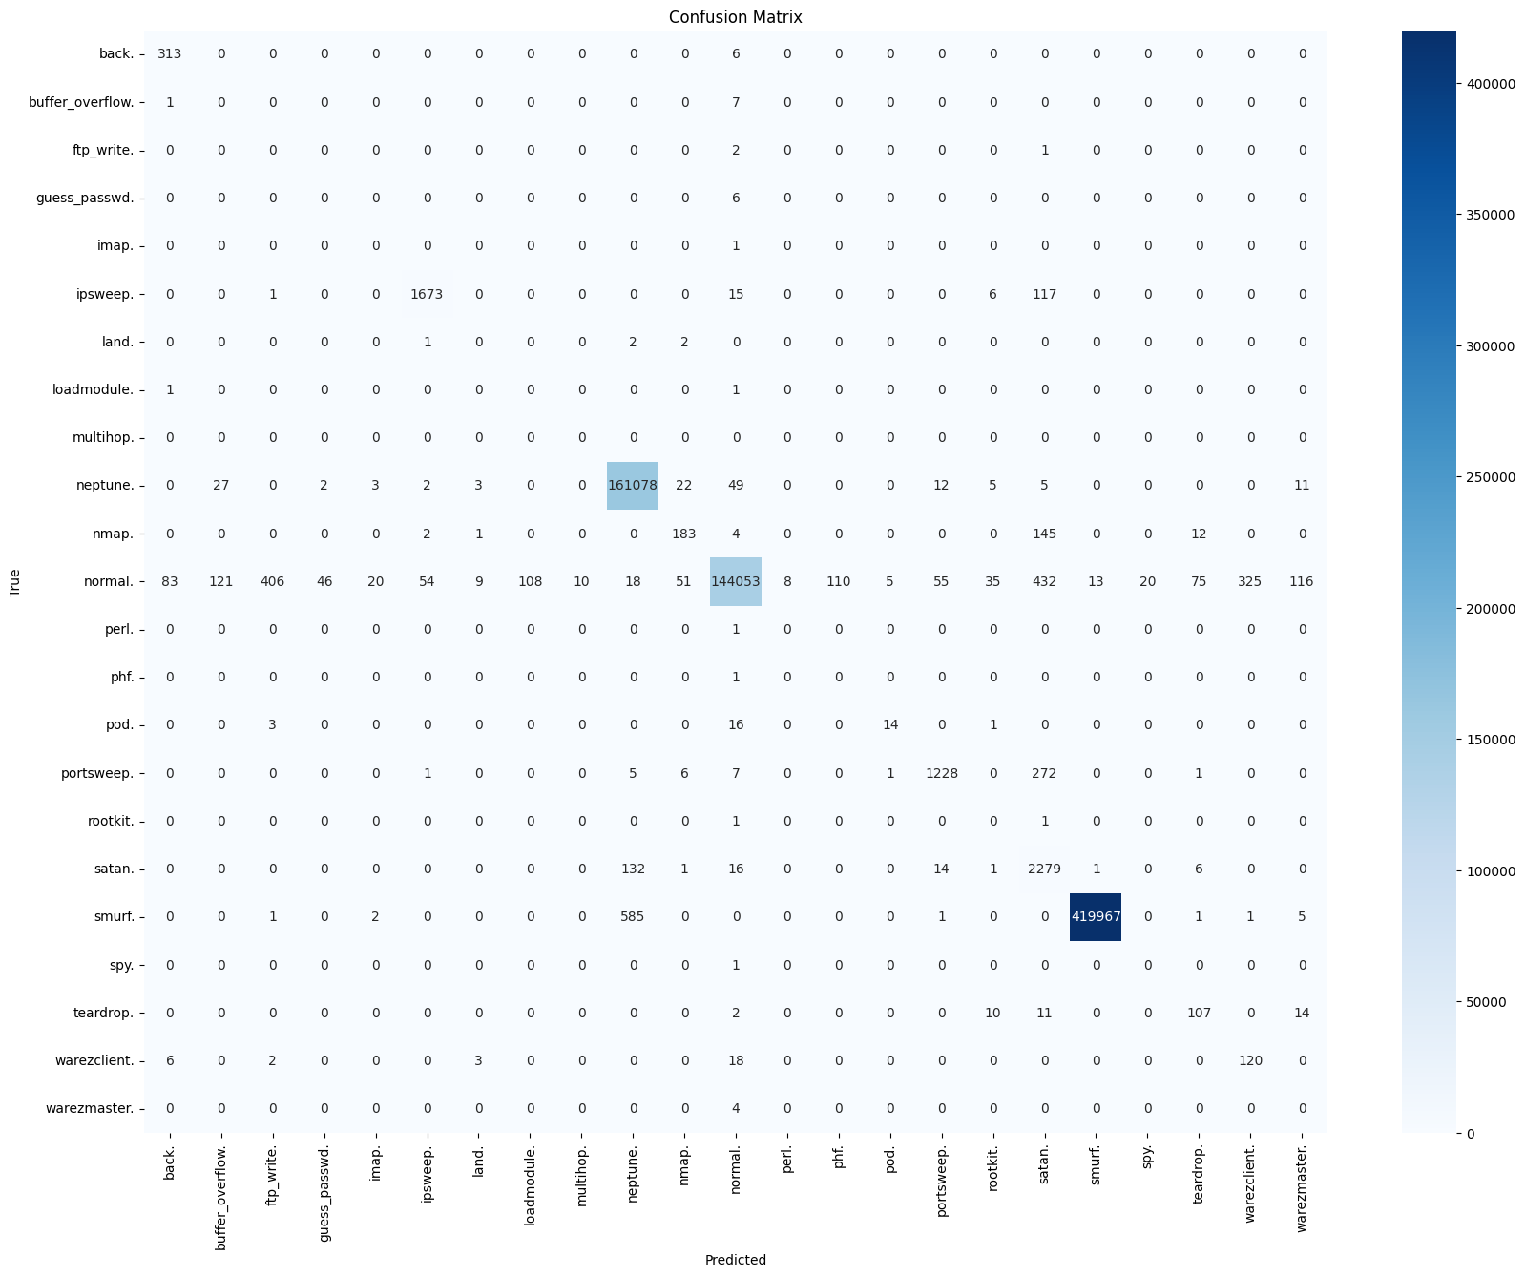
EXPERIMENTS AND RESULTS
Confusion Matrix of LightGBM on KDD Cup 1999 Dataset

Slide 22
EXPERIMENTS AND RESULTS
Sr. No. | Test, Validation, Test Ratio | Model | Precision (%) | Recall (%) | F1 Score (%) | Accuracy (%)
1 | 60:20:20 | CatBoost | 99.98 | 99.98 | 99.98 | 99.98
2 | 70:10:20 |  | 99.98 | 99.98 | 99.98 | 99.98
3 | 60:30:10 |  | 99.98 | 99.99 | 99.99 | 99.99
4 | 70:15:15 |  | 99.98 | 99.98 | 99.98 | 99.98
Average |  |  | 99.98 | 99.98 | 99.98 | 99.98
Multi-Class Classification-KDD Cup 1999 Dataset

Slide 23
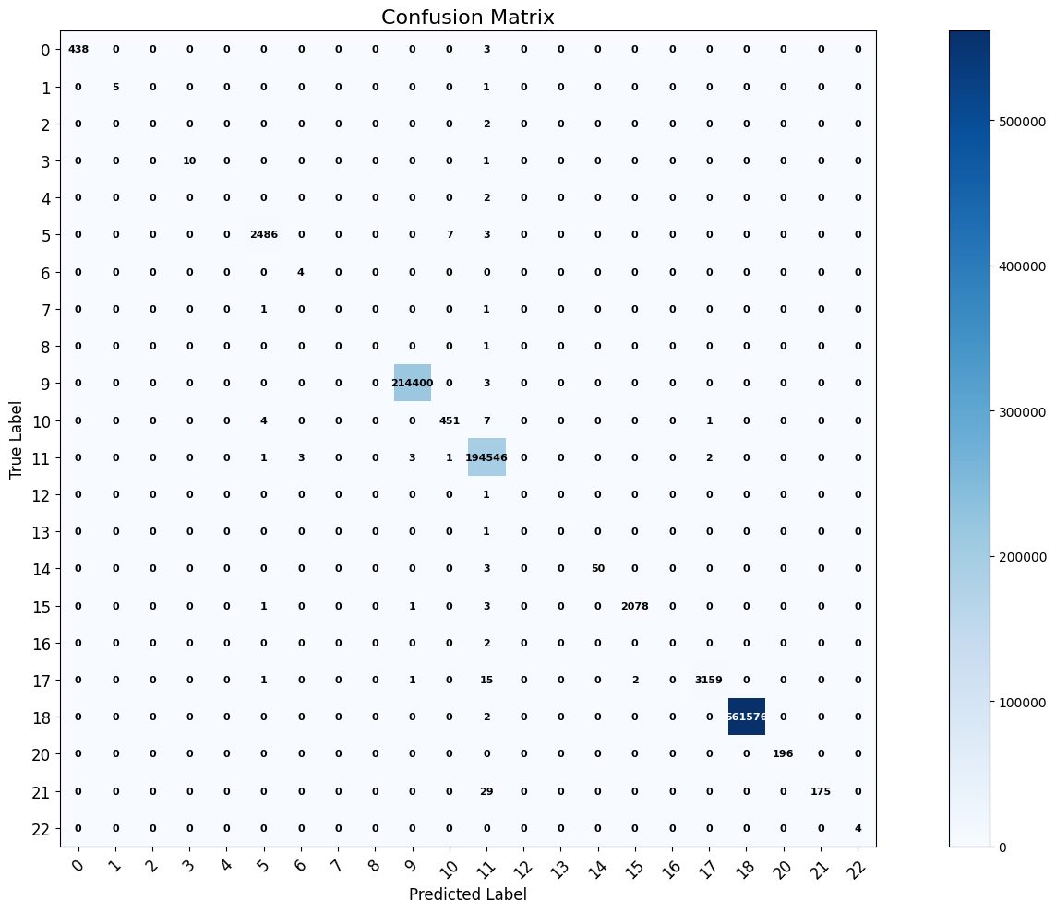
EXPERIMENTS AND RESULTS
Confusion Matrix of CatBoost on KDD Cup 1999 Dataset

Slide 24
EXPERIMENTS AND RESULTS
Sr. No. | Train Set | Validation, Test Ratio | Model | Precision (%) | Recall (%) | F1 Score (%) | Accuracy (%)
1 | Train+ | 20:80 | LightGBM | 56.93 | 67.41 | 57.39 | 93.73
2 | Train+ | 10:90 |  | 68.22 | 75.31 | 68.71 | 97.17
3 | Train+ | 40:60 |  | 50.84 | 55.84 | 48.14 | 90.90
4 | Train+ | 50:50 |  | 53.90 | 68.60 | 54.69 | 92.40
Average |  |  |  | 57.34 | 66.79 | 57.23 | 93.55
Multi-Class Classification-NSL KDD Dataset

Slide 25
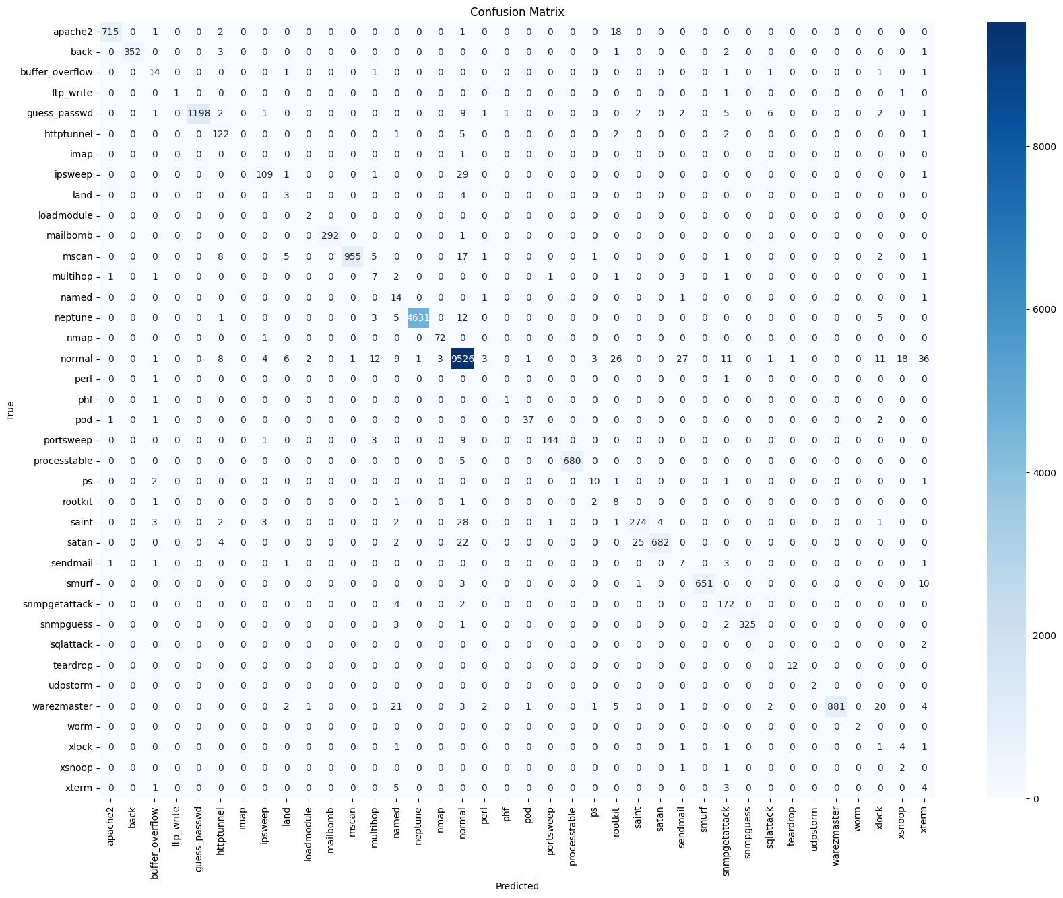
EXPERIMENTS AND RESULTS
Confusion Matrix of LightGBM on NSL KDD Dataset

Slide 26
EXPERIMENTS AND RESULTS
Sr. No. | Train Set | Validation, Test Ratio | Model | Precision (%) | Recall (%) | F1 Score (%) | Accuracy (%)
1 | Train+ | 40:60 | CatBoost | 63.19 | 47.20 | 46.59 | 74.15
2 | Train+ | 30:70 |  | 63.16 | 47.29 | 46.66 | 74.23
3 | Train+ | 20:80 |  | 63.24 | 47.37 | 46.79 | 74.35
4 | Train+ | 10:90 |  | 63.12 | 47.38 | 46.75 | 74.34
Average |  |  |  | 63.17 | 47.31 | 46.69 | 74.26
Multi-Class Classification-NSL KDD Dataset

Slide 27
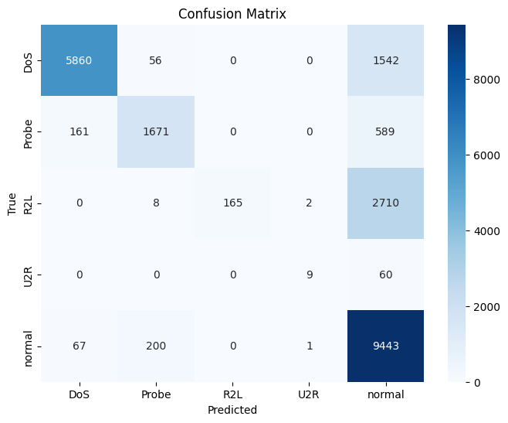
EXPERIMENTS AND RESULTS
Confusion Matrix of CatBoost on NSL KDD Dataset

Slide 28
EXPERIMENTS AND RESULTS
Sr. No. | Train, Validation, Test Ratio | Model | Precision (%) | Recall (%) | F1 Score (%) | Accuracy (%)
1 | 60:20:20 | LightGBM | 99.85 | 99.84 | 99.84 | 99.84
2 | 60:30:10 |  | 99.87 | 99.86 | 99.86 | 99.86
3 | 70:15:15 |  | 99.85 | 99.85 | 99.85 | 99.85
4 | 70:10:20 |  | 99.85 | 99.85 | 99.85 | 99.85
Average |  |  | 99.85 | 99.85 | 99.85 | 99.85
Multi-Class Classification- CICIDS-2017 Dataset

Slide 29
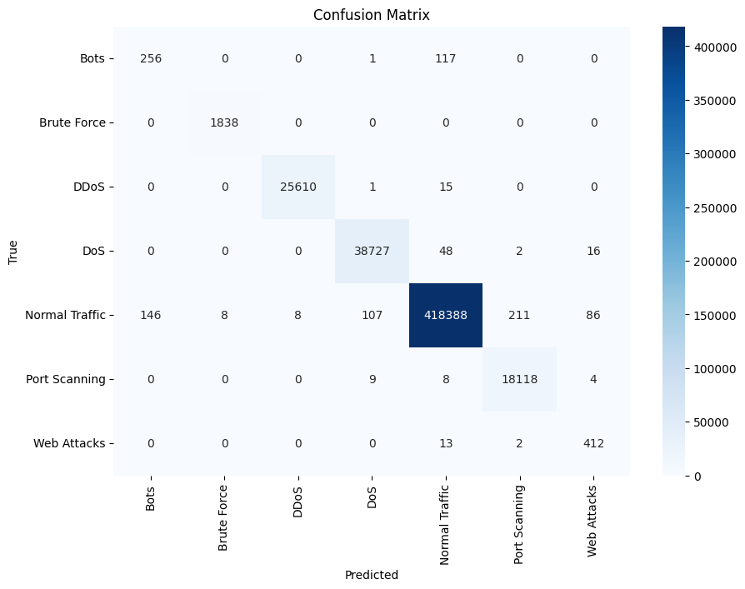
EXPERIMENTS AND RESULTS
Confusion Matrix of LightGBM on CICIDS-2017 Dataset

Slide 30
EXPERIMENTS AND RESULTS
Sr. No. | Train, Validation, Test Ratio | Model | Precision (%) | Recall (%) | F1 Score (%) | Accuracy (%)
1 | 60:20:20 | CatBoost | 99.91 | 99.91 | 99.91 | 99.90
2 | 70:15:15 |  | 99.91 | 99.91 | 99.91 | 99.91
3 | 70:10:20 |  | 99.91 | 99.91 | 99.91 | 99.90
Average |  |  | 99.91 | 99.91 | 99.91 | 99.90
Multi-Class Classification- CICIDS-2017 Dataset

Slide 31
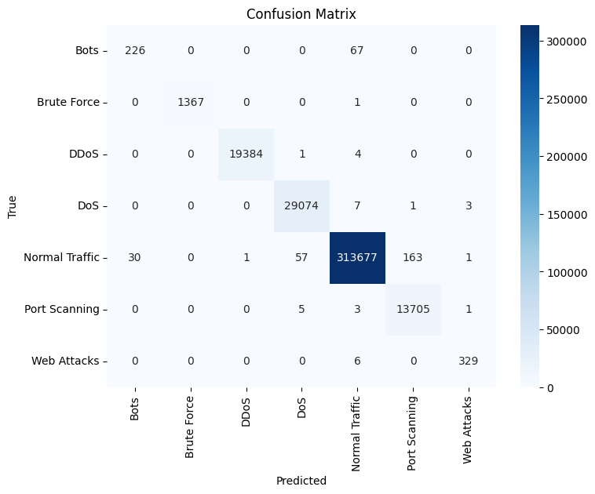
EXPERIMENTS AND RESULTS
Confusion Matrix of CatBoost on CICIDS-2017 Dataset

Slide 32
LIMITATIONS
The datasets used are generated through simulation and do not represent the real-world network traffic.
The datasets are highly imbalanced since some of the attacks are present in greater quantities than the other attacks.
In these datasets, network behavior and attacks do not evolve over time, unlike in real-world deployments.
If there is unseen attack types then these models may not generalize well.
While more efficient than deep learning approaches, LightGBM and CatBoost could still be unsuitable for direct use on sensor nodes due to limitations in memory and processing power.

Slide 33
CONCLUSION
Key Achievements:
Successfully applied LightGBM and CatBoost for multi-class classification of network traffic to detect abnormal behavior.
Performed comparative evaluation across datasets with different preprocessing, split ratios, and evaluation metrics.
Achieved accuracy of up to 99.98% with CatBoost and up to 99.90% with LightGBM on certain datasets.
Demonstrated that CatBoost performs better with high-dimensional categorical data, while LightGBM excels in complex but structured numeric datasets.
From the performance analysis of LightGBM and CatBoost, we can say that these models are effective at detecting jamming attacks in wireless sensor networks.
Identified dataset imbalance and lack of real-time variability as limiting factors for model generalization.

Slide 34
FUTURE SCOPE
Potential Improvements:
We can increase the accuracy by training the models on more datasets.
we can also increase the robustness of the model for real-world wireless networks by training the models on real-time datasets.
Combine LightGBM/CatBoost with deep learning models (e.g., CNN + Gradient Boosting) to capture both spatial and temporal attack patterns.
Implement reinforcement learning to adapt models in real time to evolving jamming behaviors.

Slide 35
REFERENCES
Alqahtani, M., Gumaei, A., Mathkour, H., & Ismail, M. M. B. (2019). A Genetic-Based extreme gradient boosting model for detecting intrusions in wireless sensor networks. Sensors, 19(20), 4383. https://doi.org/10.3390/s19204383
Osanaiye, O., Alfa, A. S., & Hancke, G. P. (2018). A statistical approach to detect jamming attacks in wireless sensor networks. Sensors, 18(6), 1691. https://doi.org/10.3390/s18061691
Tabbaa, H., Ifzarne, S., & Hafidi, I. (2022). An online ensemble learning model for detecting attacks in wireless sensor networks. arXiv preprint arXiv:2204.13814.
Jere, S., Wang, Y., Aryendu, I., Dayekh, S., & Liu, L. (2023). Bayesian Inference-Assisted Machine Learning for Near Real-Time Jamming Detection and Classification in 5G New Radio (NR). IEEE Transactions on Wireless Communications, 23(7), 7043–7059. https://doi.org/10.1109/twc.2023.3337058.

Slide 36
REFERENCES
5. Lee, S., Lee, Y., Jeon, S., & Lee, I. (2023). Machine learning-based jamming attack classification and effective defense technique. Computers & Security, 128, 103169. https://doi.org/10.1016/j.cose.2023.103169
6. Hachimi, M., Kaddoum, G., Gagnon, G., & Illy, P. (2020). Multi-stage Jamming Attacks Detection using Deep Learning Combined with Kernelized Support Vector Machine in 5G Cloud Radio Access Networks. 2022 International Symposium on Networks, Computers and Communications (ISNCC), 1–5. https://doi.org/10.1109/isncc49221.2020.9297290
7. Roopak, M., Tian, G. Y., & Chambers, J. (2019). Deep learning models for cyber security in IoT networks. 2022 IEEE 12th Annual Computing and Communication Workshop and Conference (CCWC). https://doi.org/10.1109/ccwc.2019.8666588
8. Jan, S. U., Ahmed, S., Shakhov, V., & Koo, I. (2019). Toward a lightweight intrusion detection system for the internet of things. IEEE Access, 7, 42450–42471. https://doi.org/10.1109/access.2019.2907965

Slide 37
THANK
YOU

